Slide 1
INTERIM REPORT Simulating action potentials in cardiac cells in order to determine the link between atrial fibrillation and ectopic foci in the pulmonary vein
Girish Gupta and Lucy Foster

Slide 2
Introduction
Heart disease big killer in the Western world.
Atrial fibrillation most common form of cardiac arrhythmia.
It involves the heart not beating effectively, one cause of which is believed to be an ectopic heart beat coming from the pulmonary vein.
Blood can pool then clot.
Clots getting lodged in the brain can lead to a stroke.
The aim of this project: to produce a computer model to simulate conditions believed to lead to this.

Slide 3
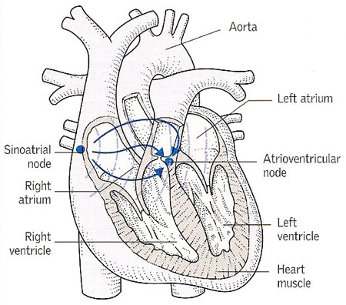
The heart
Pulmonary vein carries oxygenated blood back to the heart from the lungs.
Heart beat: a contraction with an electro-physical basis.
Starts as an action potential in a pace making cell, causing a wave of contraction to pass through the heart.
SA node natural pace-making cell of the heart.
Darling, D. <http://www.daviddarling.info/encyclopedia/S/sinoatrial_node.html>. (Image used with permission.)

Slide 4
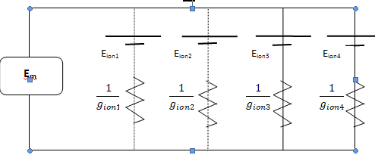




Modelling cardiac cells
Ion channel modelling:
Ion channels are gated
Voltage stimuli open and close gates.
Mathematical model to show channel activation, based upon activation variable r, it depends on whether the m and h gates are open or closed.
Hodgkin Huxley models:
Nernst potential of the ion. (equilibrium potential)
Resting potential of the membrane
Current flows because of stimulus altering membrane potential.

Slide 5
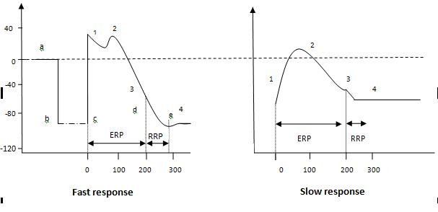
An action potential
Berne, R.M, Levy, M.N. 2000, Principles of Physiology, Modsby, Missouri.
Slow response are that off pace-making cells.
Slope of depolarisation much steeper in fast response.
Slow response initial resting potential less negative.
Overshoot of slow response less than that of fast response.

Slide 6
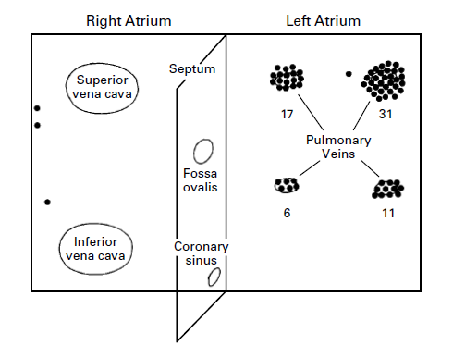
Evidence of pulmonary vein link
Atrial fibrillation comes from natural pace-making cell being overwhelmed by disorganized electrical impulses coming from elsewhere.
Atrial fibrillation: multiple activation waves within the atria.
A lot of evidence that shows not only the PV has pacemaking cells but also that this is linked to atrial fibrillation for example Haissaguerre et al and Perez Lugones et al.
Haissaguerre, M et. al. 1998, ‘Spontaneous initiation of atrial fibrillation by ectopic beats originating in the pulmonary veins, New England Journ. of Med., vol. 339, no. 10, pp. 659-666.

Slide 7
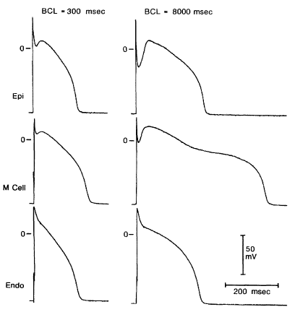
Experimental Action Potentials
Liu, D.W., Gintant, G.A., Antzelevitch, C. 1993, ‘Ionic bases for electrophysiological distinctions among epicardial, midmyocardial, and myocytes from the free wall of the canine left ventricle’, Circ. Res., vol. 72, pp. 671-687.

Slide 8
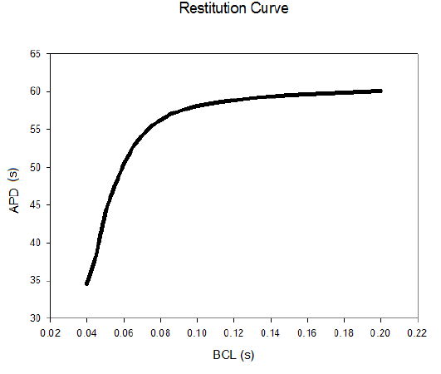
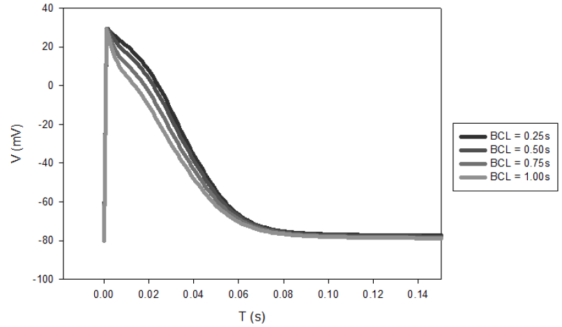
Initial Data

Slide 9
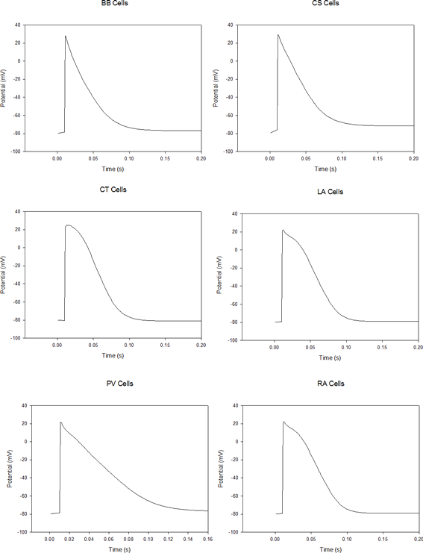
Action Potentials

Slide 10
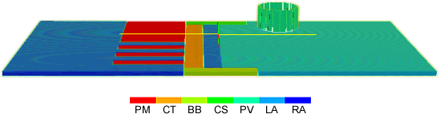
2D Geometry with 3D Extension
Edges of rectangle to be ‘stuck’ to each other via boundary conditions to form a cylinder
RA
LA
PV
Original 2D pulmonary vein location for 3D cylinder to be linked to.
Place boundary conditions here to link to ‘flat’ pulmonary vein loaction in original 2D model.

Slide 11
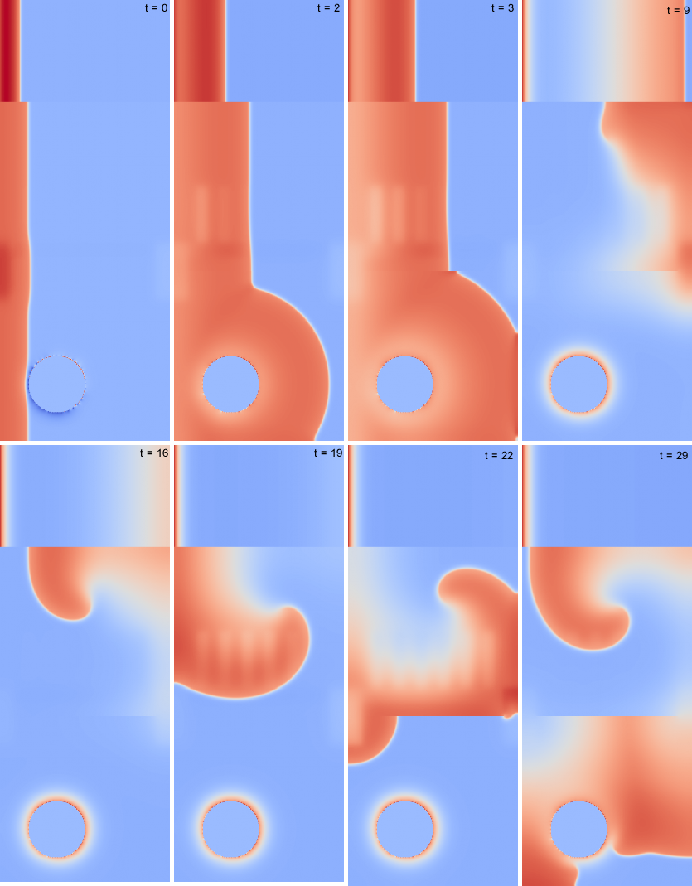
2D

Slide 12
3D Geometry

Slide 13
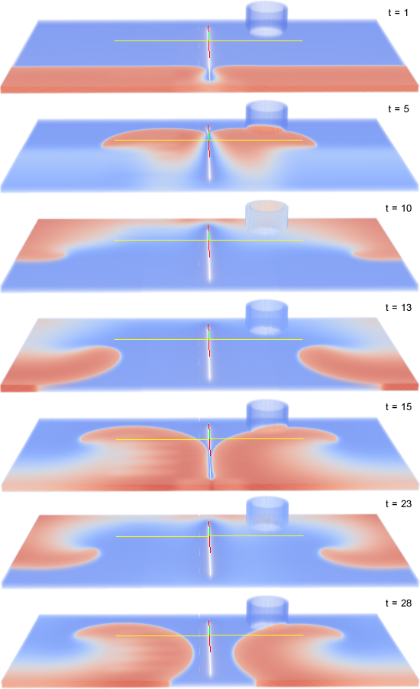
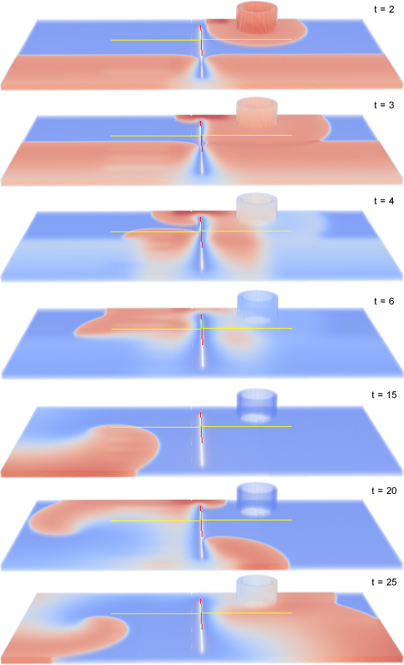

Slide 14
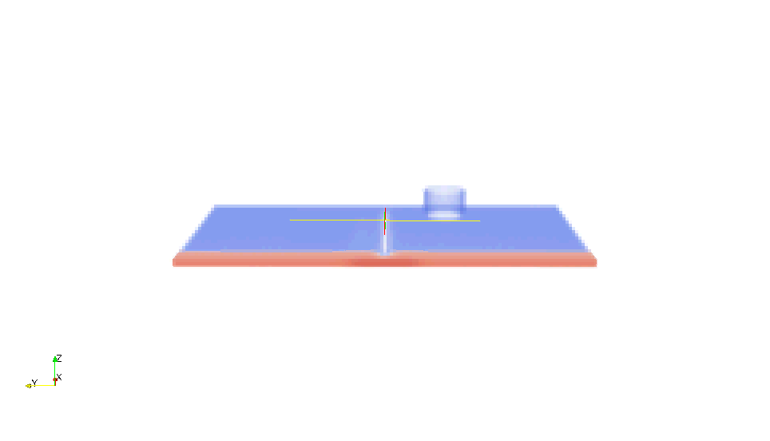
One stimulus

Slide 15
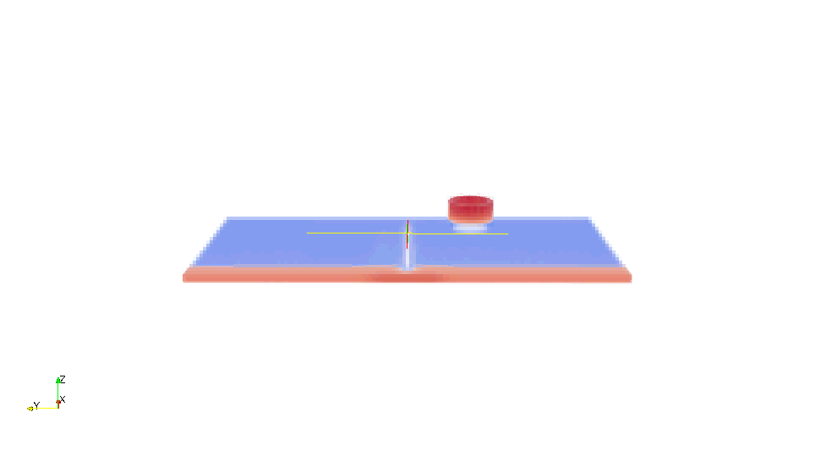
Two stimuli

Slide 16
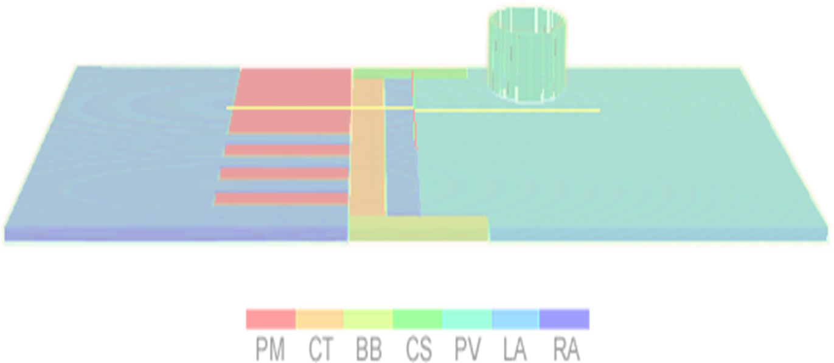
What next?
Refine the geometry file to become more anatomically accurate.
Stimulate the anatomically correct points.
Self-excitation in the pulmonary vein itself.
This and further work will establish the link between ectopic foci in the pulmonary vein and atrial fibrillation, as per our aim.

